Slide 1
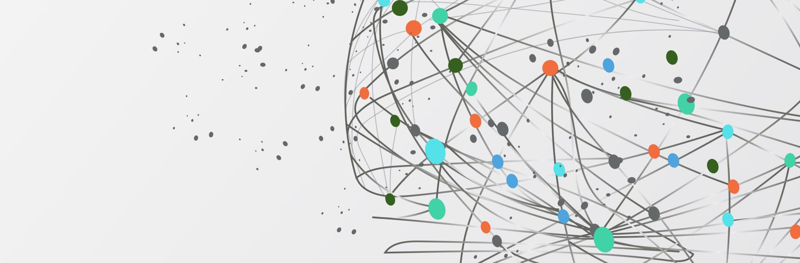
Mid-term Project Overview
Presented by Noel Li

Slide 2

1. Introduction
This project aims to develop an adaptive melody generator using machine learning techniques, specifically Markov models, implemented in MaxMSP using the ml.markov package. The system will learn from existing melodies and generate new, stylistically similar musical phrases that adapt to real-time user input, creating an interactive and dynamic composing environment.

Slide 3
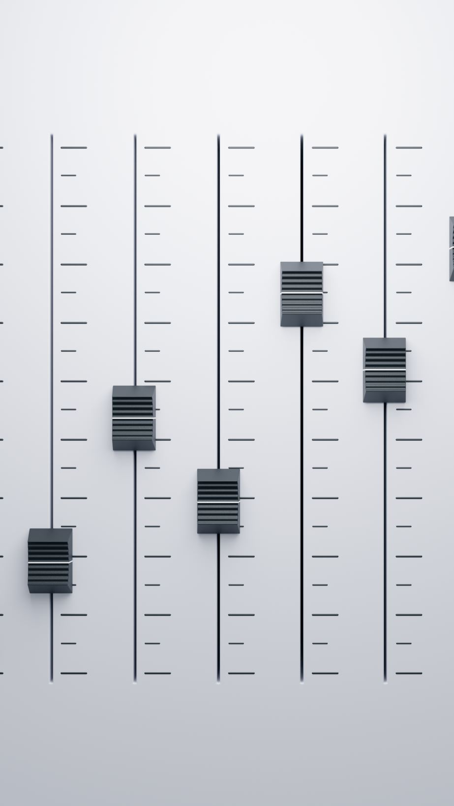
2.Background and Rationale
Markov models have been widely used in algorithmic composition due to their ability to capture and reproduce statistical patterns in sequential data. The ml.markov package extends MaxMSP's capabilities by implementing Markov chain functionality, allowing for the creation of sophisticated generative music systems.
This project bridges the gap between machine learning techniques and interactive music creation, offering a tool for composers and performers to explore new melodic ideas based on learned patterns.

Slide 4

4. Methodology

Slide 5
4.1 Data Collection and Preparation
Collect a dataset of MIDI melodies in various styles (e.g., jazz, classical, folk)
Develop a MaxMSP patch to preprocess MIDI data, extracting relevant features (pitch, duration, velocity)
Create a data format compatible with the ml.markov object

Slide 6
4.2 Model Development
Implement a Markov model using the ml.markov object.
Experiment with different order Markov chains to balance pattern recognition and variability.
Train the model on the preprocessed MIDI dataset.

Slide 7
4.3 Integration with MaxMSP
Design a user interface for controlling model parameters and melody generation
Implement real-time MIDI input/output for immediate playback
Develop a system for adapting generated melodies based on user input (e.g., chord progressions, tempo changes)

Slide 8
4.4 Testing and Evaluation
By my ears

Slide 9
4.5. Resources Needed
MaxMSP software (version 7 or later)
ml.markov package for MaxMSP
MIDI keyboard or controller for real-time input
Access to MIDI melody datasets for training

Slide 10

END

